Slide 1
CSE 453
High Performance Database Systems
Course Teacher : Md Tarikul Islam Papon

Slide 2
Distributed Database Systems (DDBS)

Slide 3
DDBS
Union of two diametrically opposed approaches
Database System
Computer Network Technologies

Slide 4
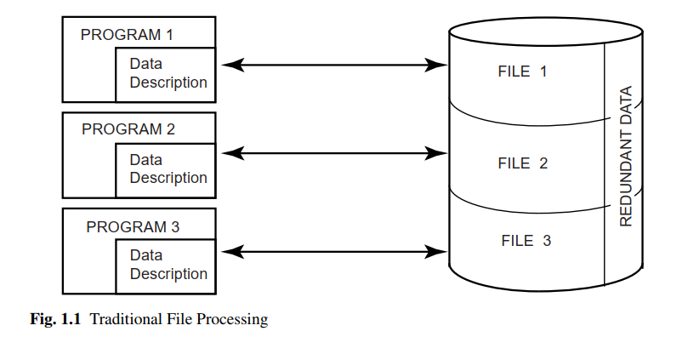
DDBS

Slide 5
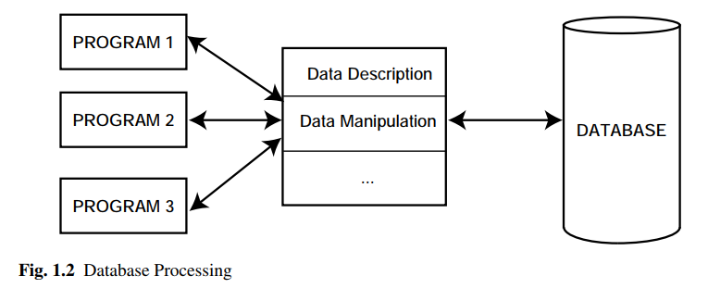
DDBS

Slide 6
DDBS
The most important objective of the database technology is integration, not centralization.
It is possible to achieve integration without centralization, and that is exactly what the distributed database technology attempts to achieve.

Slide 7
DDBS
We define a distributed database as a collection of multiple, logically interrelated databases distributed over a computer network.
How significant is the physical distribution of data ?

Slide 8
Parallel vs Distributed Database
Parallel Database | Distributed Database
Multiprocessor systems generally fall in this category. Because they are generally comprised of symmetrical, identical processors and memory components. | In distributed database systems, heterogeneity of the processors, memory and operating system in highly likely.
Machines are generally physically close to each other | Machines can far from each other
Machines connects with dedicated high-speed LANs and switches | Can be connected using public-purpose network, e.g., Internet
Communication cost is assumed to be small | Communication cost and problems cannot be ignored
Can shared-memory, shared-disk, or shared-nothing architecture | Usually shared-nothing architecture

Slide 9
Parallel vs Distributed Database
Parallel Database | Distributed Database
Multiprocessor systems generally fall in this category. Because they are generally comprised of symmetrical, identical processors and memory components. | In distributed database systems, heterogeneity of the processors, memory and operating system in highly likely.
Machines are generally physically close to each other | Machines can far from each other
Machines connects with dedicated high-speed LANs and switches | Can be connected using public-purpose network, e.g., Internet
Communication cost is assumed to be small | Communication cost and problems cannot be ignored
Can shared-memory, shared-disk, or shared-nothing architecture | Usually shared-nothing architecture

Slide 10
Parallel vs Distributed Database
Parallel Database | Distributed Database
Multiprocessor systems generally fall in this category. Because they are generally comprised of symmetrical, identical processors and memory components. | In distributed database systems, heterogeneity of the processors, memory and operating system in highly likely.
Machines are generally physically close to each other | Machines can far from each other
Machines connects with dedicated high-speed LANs and switches | Can be connected using public-purpose network, e.g., Internet
Communication cost is assumed to be small | Communication cost and problems cannot be ignored
Can shared-memory, shared-disk, or shared-nothing architecture | Usually shared-nothing architecture

Slide 11
Parallel vs Distributed Database
Parallel Database | Distributed Database
Multiprocessor systems generally fall in this category. Because they are generally comprised of symmetrical, identical processors and memory components. | In distributed database systems, heterogeneity of the processors, memory and operating system in highly likely.
Machines are generally physically close to each other | Machines can far from each other
Machines connects with dedicated high-speed LANs and switches | Can be connected using public-purpose network, e.g., Internet
Communication cost is assumed to be small | Communication cost and problems cannot be ignored
Can shared-memory, shared-disk, or shared-nothing architecture | Usually shared-nothing architecture

Slide 12
Parallel vs Distributed Database
Parallel Database | Distributed Database
Multiprocessor systems generally fall in this category. Because they are generally comprised of symmetrical, identical processors and memory components. | In distributed database systems, heterogeneity of the processors, memory and operating system in highly likely.
Machines are generally physically close to each other | Machines can far from each other
Machines connects with dedicated high-speed LANs and switches | Can be connected using public-purpose network, e.g., Internet
Communication cost is assumed to be small | Communication cost and problems cannot be ignored
Can shared-memory, shared-disk, or shared-nothing architecture | Usually shared-nothing architecture

Slide 13
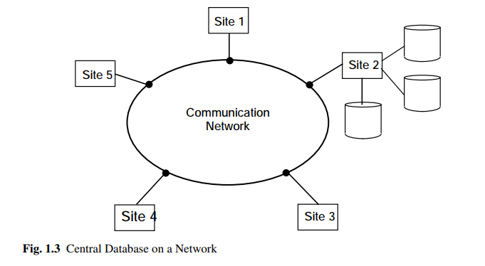
Central Database on a Network

Slide 14
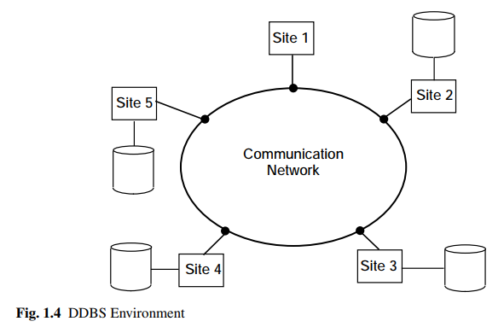
DDBS

Slide 15
Data Delivery
Delivery modes
Frequency
Communication methods

Slide 16
Data Delivery- Delivery Modes
Pull-Only
Initiated by a client pull
New data items or updates to existing data are carried out at a server without notification to clients
Servers must be interrupted continuously
Push-Only
Initiated by a server push
Deciding which data would be of common interest, and when to send them to clients
Hybrid
Combination of both

Slide 17
Data Delivery- Frequency
Periodic
Data are sent from the server to clients at regular intervals
Regular and pre-specified repeating schedule
Conditional
Data are sent from servers whenever certain conditions are satisfied
Ad-hoc or Irregular
Irregular and is performed mostly in a pure pull-based system

Slide 18
Data Delivery- Communication methods
Unicast
Multicast

Slide 19
Promises of DDBS
Transparent management of distributed and replicated data
Reliable access to data through distributed transactions
Improved performance
Easier system expansion

Slide 20
Transparency Management
Transparency refers to separation of the higher-level semantics of a system from lower-level implementation issues. In other words, a transparent system “hides” the implementation details from users.

Slide 21
Transparency Management
Consider the following schema
Table | Property
Employee | Eno, Name, Title
Project | Pno, Pname, Budget
Salary | Title, Amount
Assignment | Eno, Pno, Responsibility, Duration
Fragmentation is essential in this case for distributed computation

Slide 22
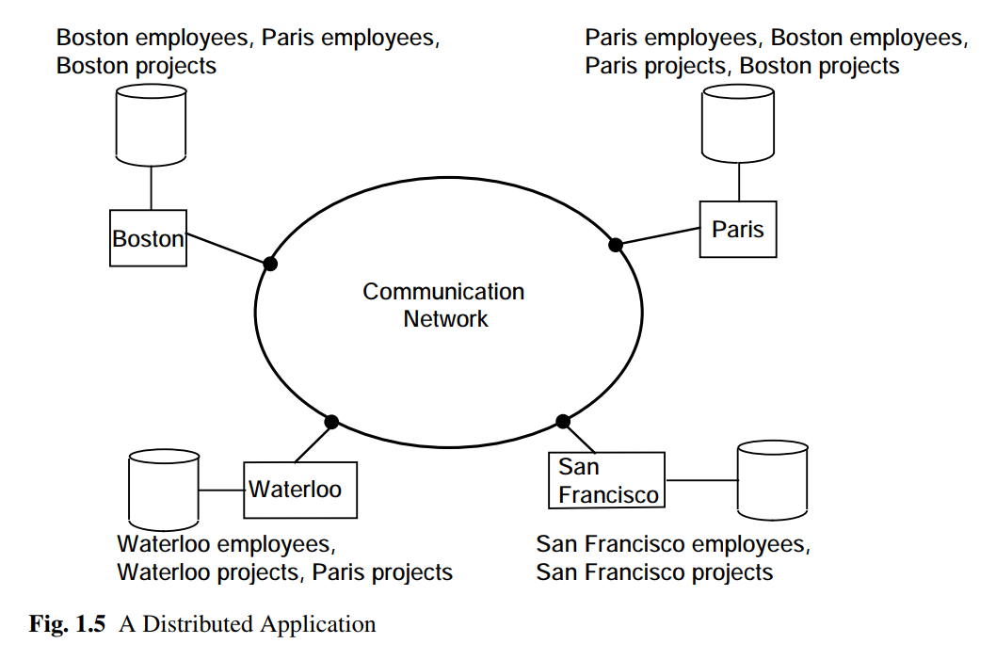
Transparency Management

Slide 23
Transparency Management
Data Independence
Logical Data Independence
Physical Data Independence
Network Transparency
Replication Transparency
Fragmentation Transparency

Slide 24
Transparency Management
Who should provide transparency?
Access Layer
Operating System (Problems!!)
DBMS

Slide 25
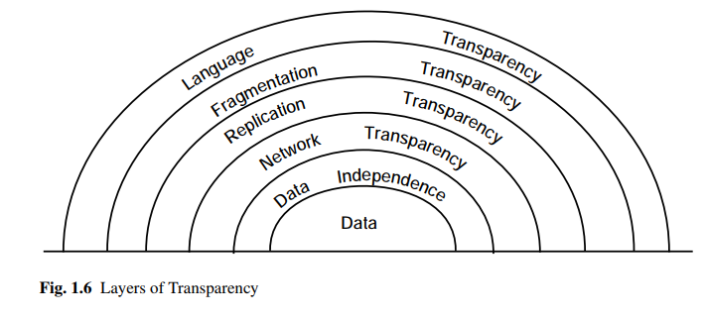
Transparency Management

Slide 26
Reliability
No single point failure
A transaction is a basic unit of consistent and reliable computing, consisting of a sequence of database operations executed as an atomic action.
It transforms a consistent database state to another consistent database state even when a number of such transactions are executed concurrently and even when failures occur.

Slide 27
Reliability
Distributed transactions execute at a number of sites at which they access the local database.
With full support for distributed transactions, user applications can access a single logical image of the database and rely on the distributed DBMS to ensure that their requests will be executed correctly no matter what happens in the system.

Slide 28
Improved Performance
A distributed DBMS fragments the conceptual database, enabling data to be stored in close proximity to its points of use (also called data localization).
Less contention
Reduction in remote access delays

Slide 29
Easier System Expansion
It is much easier to accommodate increasing database sizes.
Expansion can usually be handled by adding processing and storage power to the network.
Less cost

Slide 30
Complications by Distribution
Replication
Recovery
Synchronization of transactions
These are the inherent complexity of building distributed applications, increased cost of replicating resources, and, more importantly, managing distribution, the devolution of control to many centers and the difficulty of reaching agreements, and the exacerbated security concerns (the secure communication channel problem)

Slide 31
Design Issues
Distributed Database Design
Distributed Directory Management
Distributed Query Processing
Distributed Concurrency Control
Distributed Deadlock Management
Reliability of Distributed DBMS
Replication
Relationship among Problems
Other issues

Slide 32
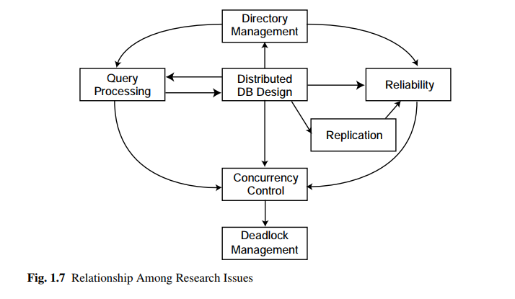
Design Issues

Slide 33
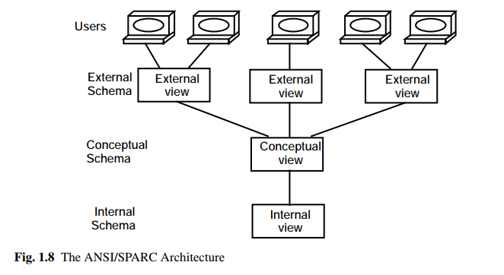
DBMS Architecture
ANSI/SPARC Architecture

Slide 34
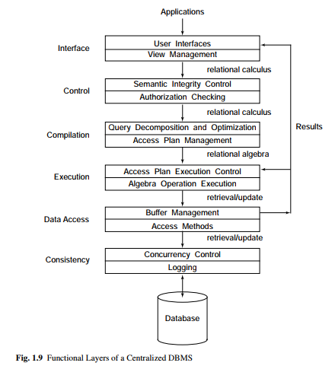
DBMS Architecture
A Generic Centralized DBMS Architecture

Slide 35
Distributed DBMS Architecture
Three dimensions
Autonomy
Distribution
Heterogeneity

Slide 36
Autonomy
Autonomy, refers to the distribution of control, not of data.
Requirements:
The local operations of the individual DBMSs are not affected by their participation in the distributed system.
The manner in which the individual DBMSs process queries and optimize them should not be affected by the execution of global queries that access multiple databases.
System consistency or operation should not be compromised when individual DBMSs join or leave the distributed system.

Slide 37
Autonomy
Dimensions of autonomy
Design autonomy: Individual DBMSs are free to use the data models and transaction management techniques that they prefer.
Communication autonomy: Each of the individual DBMSs is free to make its own decision as to what type of information it wants to provide to the other DBMSs or to the software that controls their global execution.
Execution autonomy: Each DBMS can execute the transactions that are submitted to it in any way that it wants to.

Slide 38
Distribution
Distribution dimension of the taxonomy deals with data
Two classes
client/server distribution
peer-to-peer distribution

Slide 39
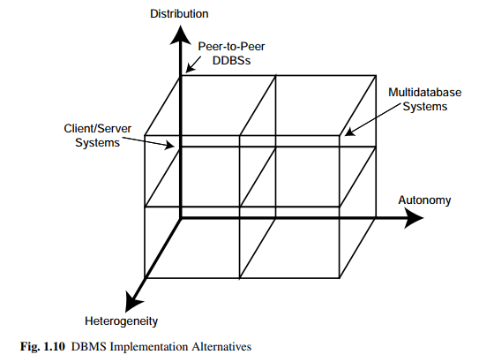
Distributed DBMS Architecture

Slide 40
Client/Server Systems
General Idea
Distinguish the functionality that needs to be provided and divide these functions into two classes: server functions
and client functions.
This provides a two-level architecture which makes it easier to manage the complexity of modern DBMSs and the complexity of distribution.

Slide 41
Client/Server Systems
“Client/Server computing” and “Client/Server DBMS,” as it is used in our context, do not refer to processes, but to actual machines.
Thus, we focus on what software should run on the client machines and what software should run on the server machine.

Slide 42
Client/Server Systems
Server Functions
Data management
Query processing & optimization
Transaction management
Storage management
Client Functions
DBMS client module
Consistency checking of user queries

Slide 43
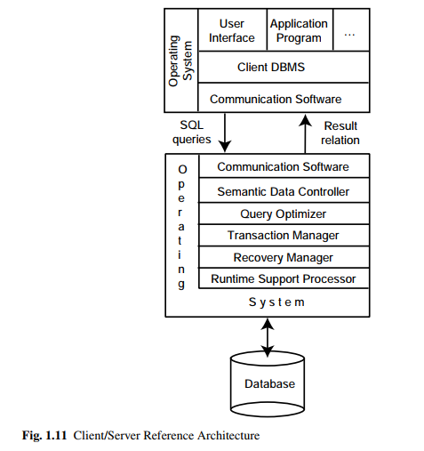
Client/Server Systems

Slide 44
Client/Server Systems
There are a number of different types of client/server architecture.
Multiple client/single server
Multiple client/multiple server (Two management strategy )
Each client manages its own connection to the appropriate server.
Each client knows of only its “home server” which then communicates with other servers as required.

Slide 45
Client/Server Systems
Client Servers
Application Servers
Database Servers

Slide 46
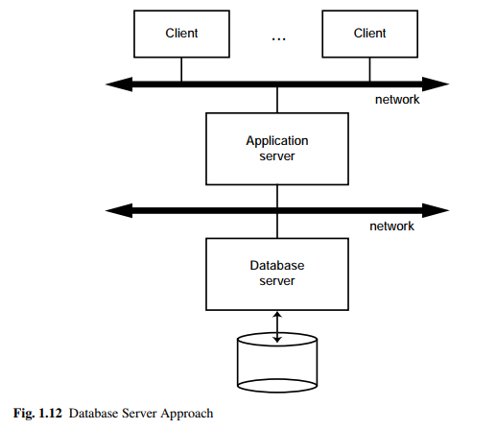
Client/Server Systems

Slide 47
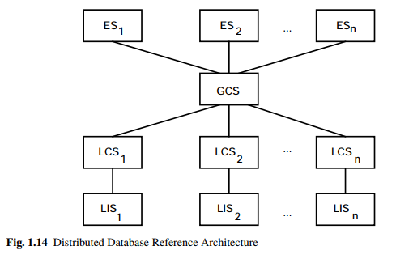
Peer-to-Peer Systems

Slide 48
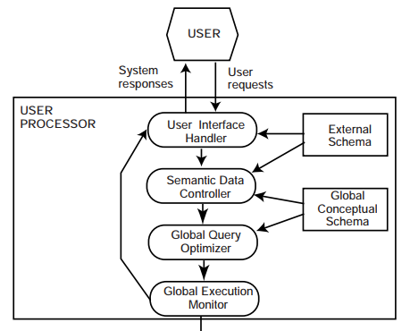
Distributed DBMS

Slide 49
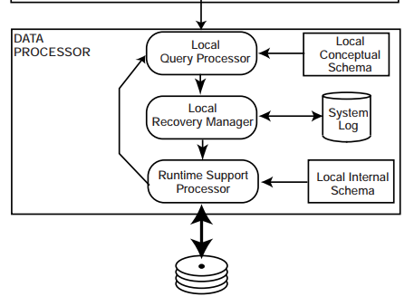
Distributed DBMS

Slide 50
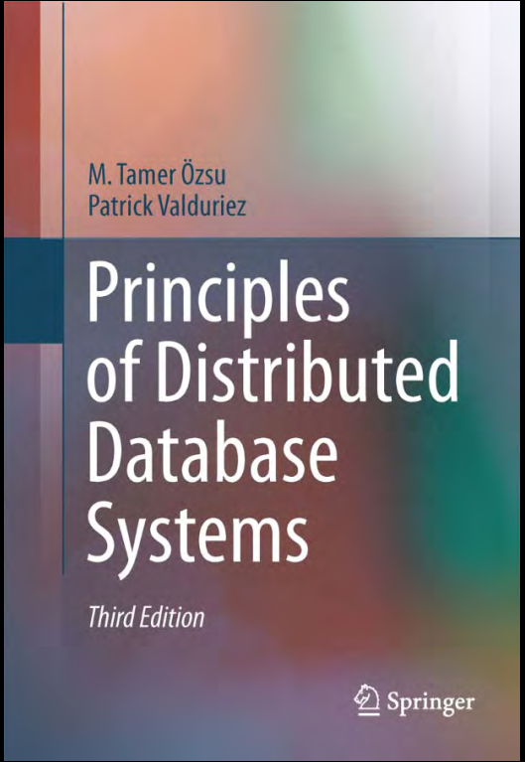
Reference
Chapter 1

Slide 51
THANK YOU!!!

